Slide 1
Credit Card IC Chips
Prof Vadhva CPE 186
Presented by: Daniel Komac

Slide 2
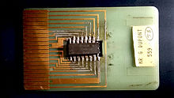
History
Roland Moreno in 1975.
First mass use was for telephones in France, 1983
Debit/Credit transactions occurred in 1993 in Europe
1994-1998 became stable
America began regular use in 2014
Contact -> Contactless

Slide 3
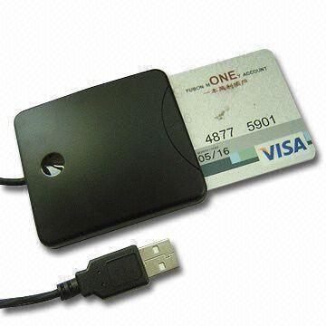
Concept
Safer
Faster
Reliable
Less material
Less power

Slide 4
Contact vs Contactless
Contact
Requires physical link
More connections needed
More secure
Contactless
No link required
Fast transactions
High frequency device
Only works in close proximaty to antenna

Slide 5
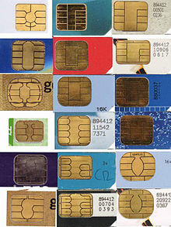
Hardware
Gold plated chips with specific pin out
Strong microprocessors
Many security protocols
ISO/IEC 7816, frequency 13.56 MHz
ISO/IEC 14443
RNG, encryption, wait states, random variable checks, clock, power analysis.
Very secure technology

Slide 6
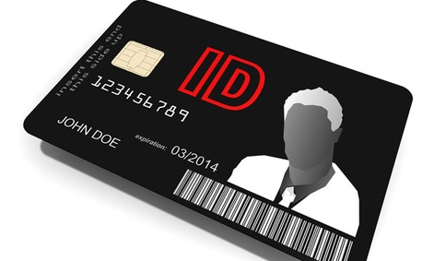
Field Applications
SIM cards
Biometrics
Personal ID
Security grants
Physical area access
Network access
Medical info

